Slide 1
Colab pro

Slide 2
About The Project
Our platform serves as a dynamic hub for fostering collaboration between organizations and individuals passionate about technology, innovation, and project development. Whether you're an organization seeking skilled contributors or an individual looking to join exciting projects, we provide the tools and resources to facilitate meaningful connections and fruitful collaborations.
For Organizations
The dashboard serves as your central command center, offering intuitive project creation and management interfaces. Seamlessly post projects and project ideas, manage team members, and engage in collaborative discussions with ease. With access to our comprehensive organization listing page, you can showcase your initiatives and attract talented individuals eager to contribute to your vision.

Slide 3
An Overview Of The Problem
Traditional project management approaches often lack efficient means for collaboration and talent acquisition, resulting in inefficiencies, delays, and suboptimal outcomes. Likewise, individual members seeking opportunities to contribute their skills and expertise to meaningful projects may face challenges in identifying suitable opportunities and connecting with relevant organizations or project leads.
Existing platforms may offer partial solutions to these challenges, but they often lack integration, user-friendly interfaces, or robust features tailored specifically to the needs of project managers and team members. As a result, organizations and individuals may struggle to find suitable matches for their projects or talents, leading to missed opportunities and underutilization of resources.
.

Slide 4
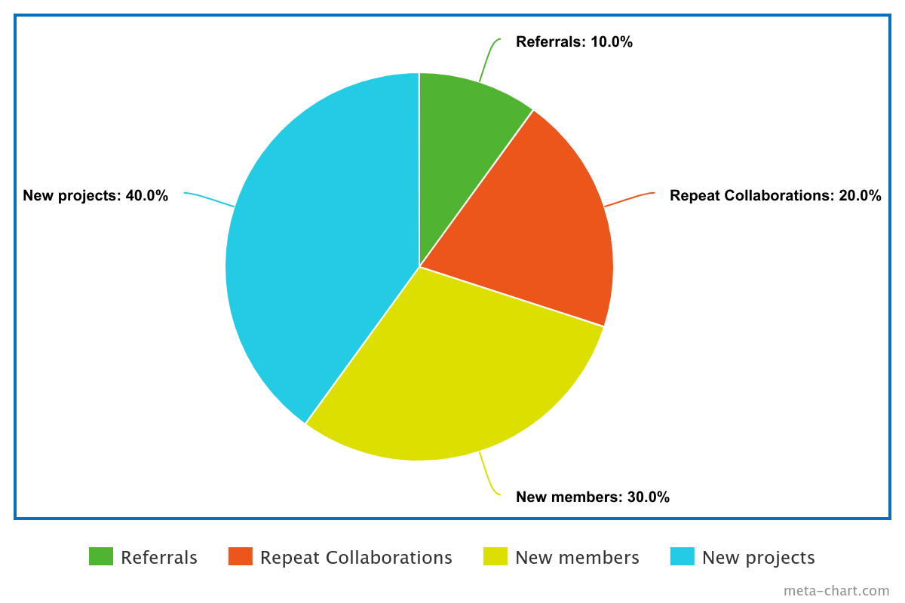
Our Expected Growth Path
we anticipate a steady increase in both the number of organizations posting projects and the pool of members joining to contribute their skills.

Slide 5
Streamlined Project Management
This includes posting project details, managing team members, and fostering collaboration
Efficient Talent Acquisition
Our platform will allow members to filter projects based on their skills, interests, and preferences, enabling them to find the perfect match for their expertise.
What We Are Looking To Achieve
Facilitating Collaboration
Collaboration is at the heart of our platform. We envision a space where project teams can communicate in real-time, share ideas, and collaborate on tasks effectively.
Enhancing User Experience
User experience is paramount in our platform design. We are committed to creating intuitive interfaces that make navigation and interaction seamless for both organizations and members.

Slide 6
Points Of Service
it provides a curated marketplace of projects across various domains, allowing them to showcase their skills, gain valuable experience, and contribute to impactful initiatives..
Project Matching
skill Development
Project Management
curated marketplace of projects and project idea
our platform serves as a gateway to skill development opportunities and networking.
Proactively envisioned multimedia expert.

Slide 7
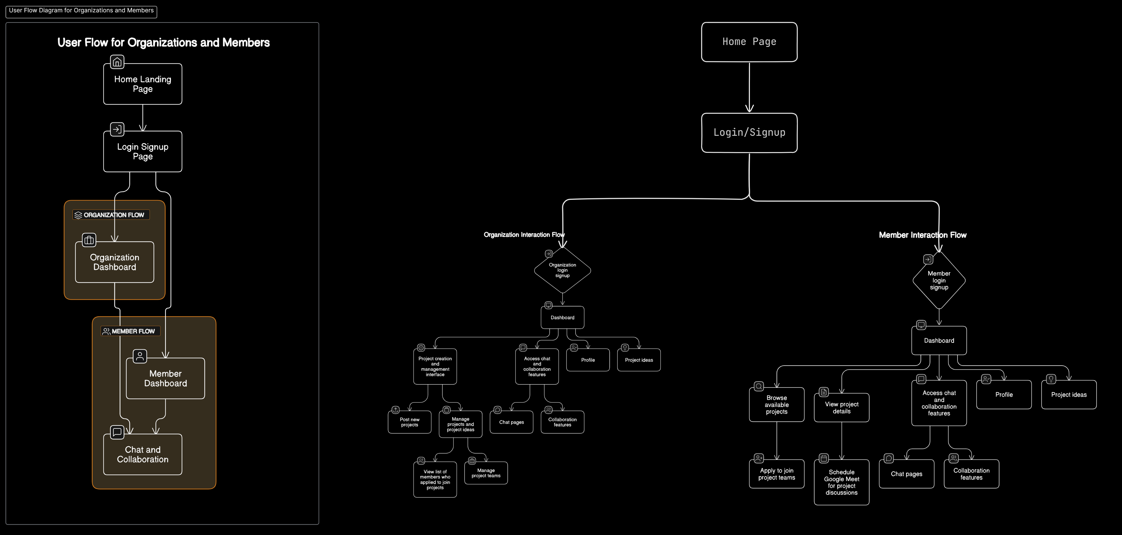
Project Workflow

Slide 8
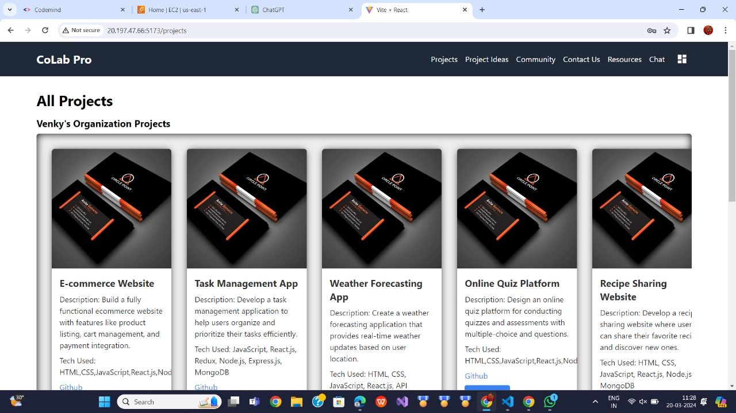
Demonstration of the platform's interface and workflow
Home/Landing Page:
Displays all organization projects and project ideas.
Provides links to login/register pages.
Offers an overview of platform functionalities.
Allows members to view project details and contact project leads.
Login/Signup Page:
Separate forms for Organizations and Members.
Allows registration and login with necessary details.
organization Pages:
Dashboard:
Project creation and management interface.
Posting projects and project ideas.
Managing projects and project ideas. Access to chat and collaboration
features.
Organization Listing Page:
Lists registered organizations and allows organizations to post new projects .

Slide 9
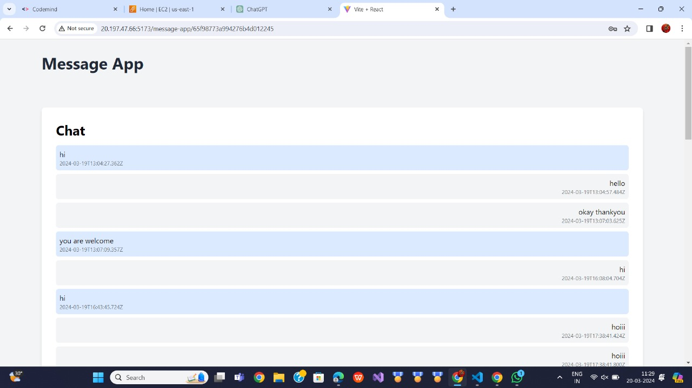
Introduction:
Brief overview of project management and collaboration tools.
Importance of effective communication in project management.
Introduction to chat box feature for project discussions.
Key Features of Chat Box:
Real-time communication: Discuss project-related matters instantly.
Group chats: Facilitate discussions among team members.
Threaded conversations: Organize discussions around specific topics.
Integration with project management tools: Seamlessly connect chat discussions with project tasks and updates.
Benefits of Using Chat Box:
Improved collaboration: Enhance teamwork by providing a central platform for discussions.
Increased productivity: Resolve issues and make decisions quickly with instant communication.
Documentation of discussions: Keep track of conversations and decisions for future reference.
Remote collaboration: Enable teams to collaborate effectively regardless of location or time zone.
Enhanced project transparency: Ensure all team members are aware of project updates and decisions.

Slide 10
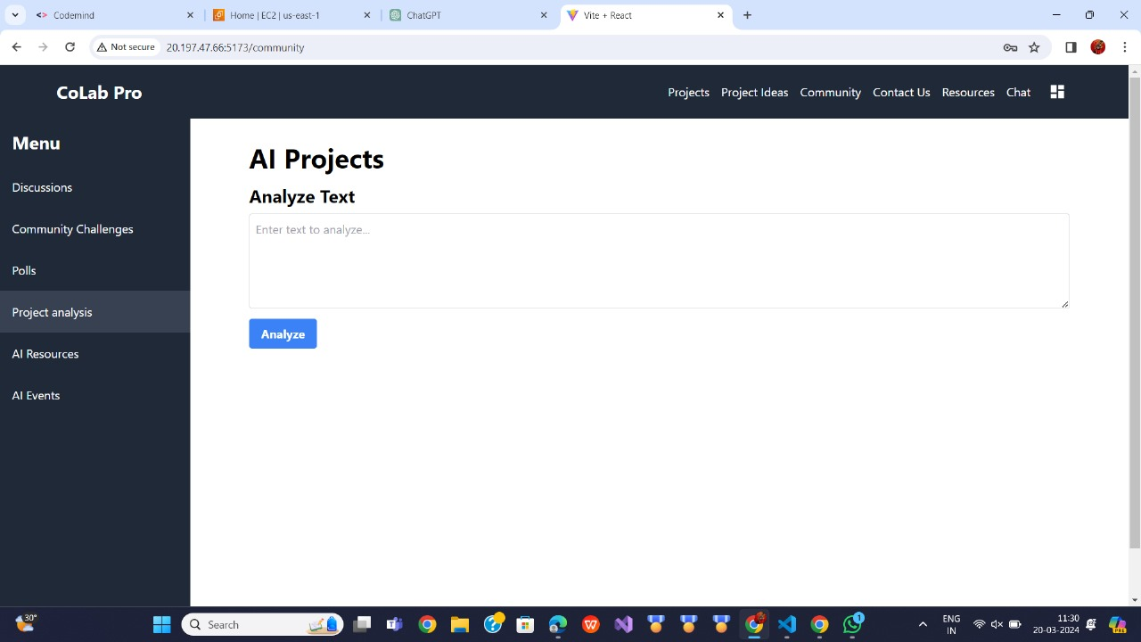
AI Analysis
AI text analysis refers to the process of extracting insights and understanding from textual data using artificial intelligence techniques. Natural Language Processing (NLP) algorithms enable machines to comprehend, interpret, and generate human language.Applications of AI text analysis range from sentiment analysis and topic modeling to text summarization and language translation. Sentiment analysis helps businesses gauge public opinion and customer feedback, enabling better decision-making and reputation management. Topic modeling techniques like Latent Dirichlet Allocation (LDA) uncover underlying themes within large text datasets.

Slide 11
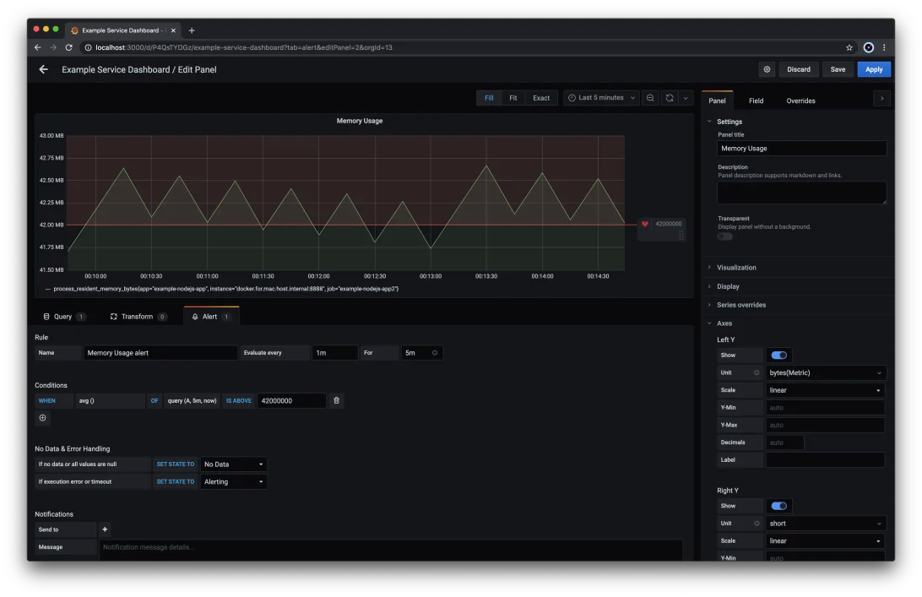
Monitoring
Prometheus:
Prometheus is an open-source monitoring and alerting toolkit designed for reliability and scalability. It collects metrics from targets by scraping HTTP endpoints, allowing monitoring of various systems and services.
Grafana:
Grafana is an open-source analytics and visualization platform used to create, explore, and share interactive dashboards.
It integrates with various data sources, including Prometheus, to visualize metrics and create meaningful insights .
Grafana supports a wide range of visualizations, such as graphs, charts, gauges, and tables, enhancing data interpretation.

Slide 12
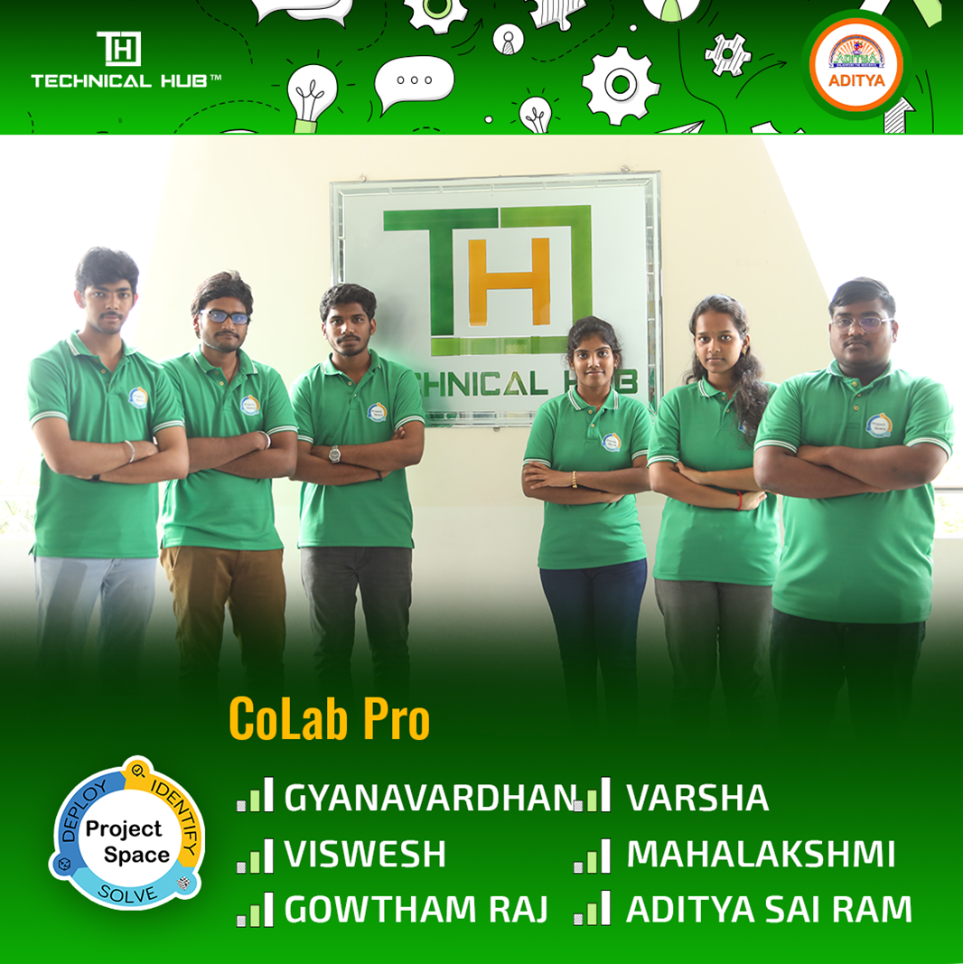
Our Team
GYANAVARDHAN(TL)
VISWESH
GOWTHAM RAJ
VARSHA
MAHALAKSHMI
ADITYA SAI RAM

Slide 13


